Slide 1

YTP Arduino – Lesson 4
Aug 2018

Slide 2
Goals
To know your way around the Arduino IDE
To understand the purpose of variables & functions
To understand basic code constructs
Success Criteria
Understand how to use the Arduino IDE
Complete basic coding exercises

Slide 3
Arduino IDE Checks
Open Arduino
Plugin your Arduino
Check your board
Check your port

Slide 4
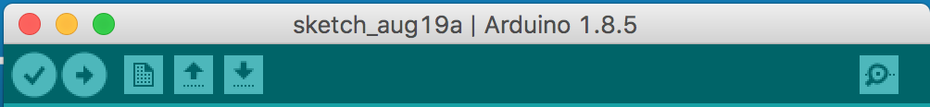
The Toolbar
Verify Code
Upload Code
Serial Monitor

Slide 5
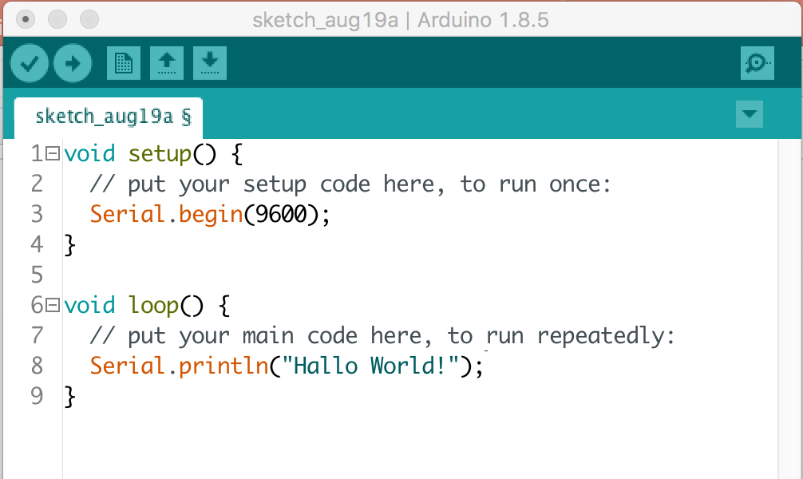
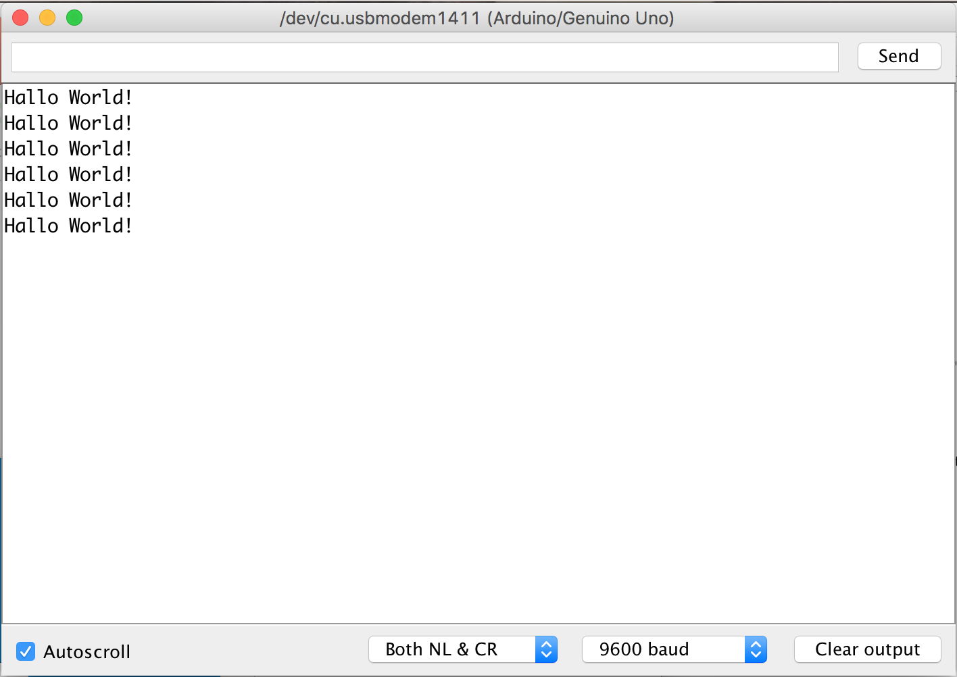
The Serial Monitor

Slide 6
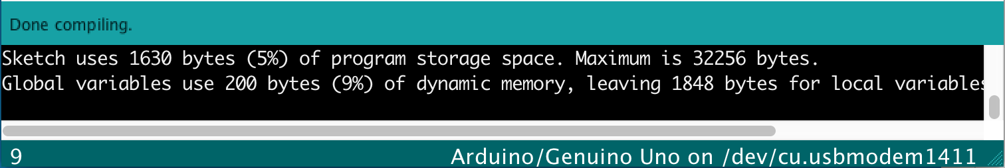
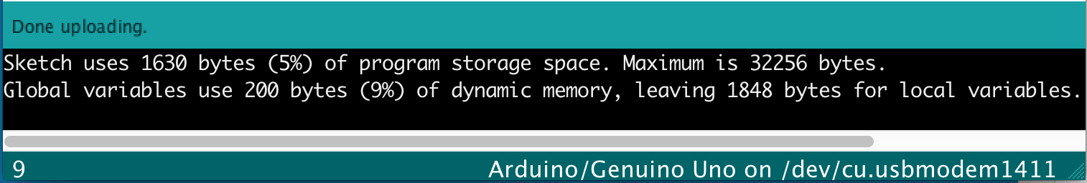
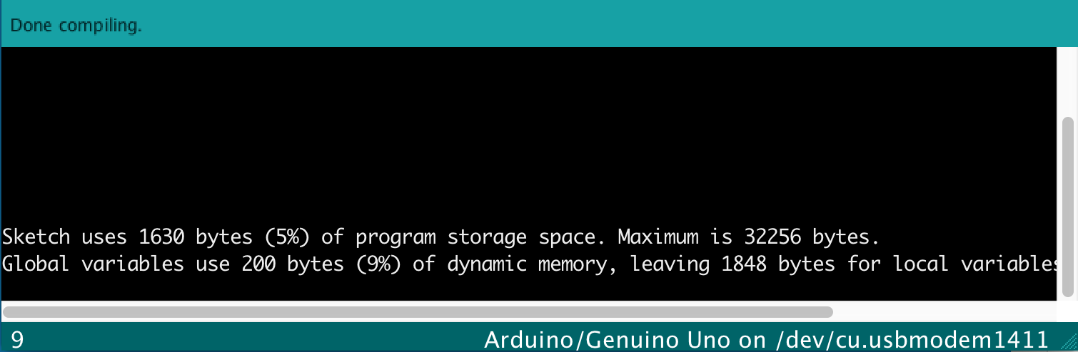
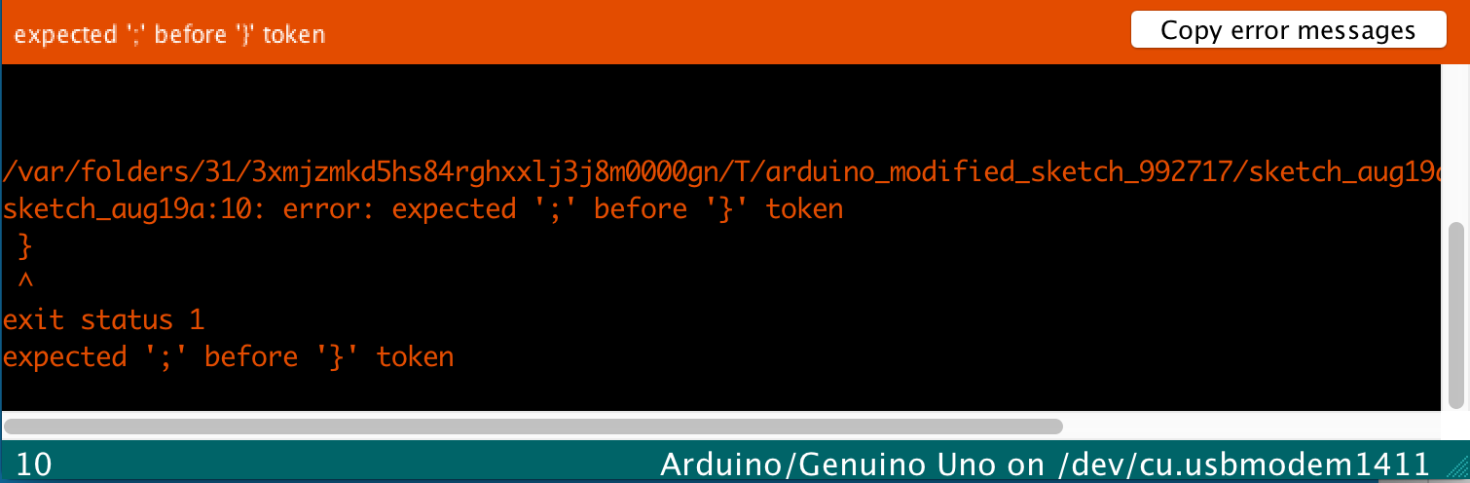
The Message Window

Slide 7
What are Functions ?
Functions are actions !

Slide 8
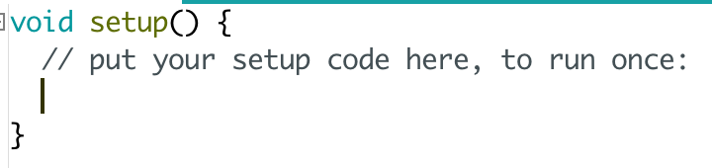
What does a Function look like ?
Name
Receive values
Return type
Start of function
Code
End of function

Slide 9
Making Toast
void makeToast () {
// Write steps to make toast
}
How many slices will this function make?
Will it be well done, medium or light ?

Slide 10
Making Toast II
void makeToast (numSlices, cookTimeInMinutes) {
// Write steps to make toast
}

Slide 11
Making Toast III
void makeToast (numSlices, cookTimeInMinutes) {
// Write steps to make toast
}
makeToast(2, 5)
makeToast(4, 10)
makeToast(10, 25)

Slide 12
Write your own Function
Here are some examples !
brushTeeth()
goToBed()
makeCoffee()
getReadyForSchool()
eatDinner()

Slide 13
Breakfast Making Machine

Slide 14
How to make Breakfast using Functions
INPUT
makeBreakfast
()
OUTPUT
“Can you make breakfast please?”

Slide 15
Breaking down makeBreakfast()
void makeBreakfast(int a, int b, int c, int d) {
}
if(a == 1){
makeCoffee(); // What?? Another function ???
}
if(b == 1){
makeScrambledEggs();
}
if(c == 1){
makeCheeriosCereal();
}
if(d == 1){
makeOrangeJuice();
}

Slide 16
Breaking down makeCoffee()
void makeCoffee() {
}
// Get coffee beans
// Grind coffee beans
// Add water
// Coffee is ready

Slide 17
Putting it all together
“Can you make breakfast please – coffee and eggs?”
makeBreakfast(1,1,0,0)
makeCoffee()
makeScrambledEggs()

Slide 18
Challenge: Making different breakfasts
What will these function calls to makeBreakfast actually make?
makeBreakfast(1,0,0,0); // What will this make ???
makeBreakfast(0,1,1,0); // What will this make ???
makeBreakfast(1,1,1,1); // What will this make ???
How would I make eggs ONLY ?
makeBreakfast(); // Insert code to make eggs ONLY

Slide 19
Variables, Constants & Assignments
= 5
= 4
= 6

Slide 20
Variables, Constants & Assignments
? =
+

Slide 21
Variables in Code
int banana = 4;
int orange = 5;
int apple = 6;
? = orange + apple

Slide 22
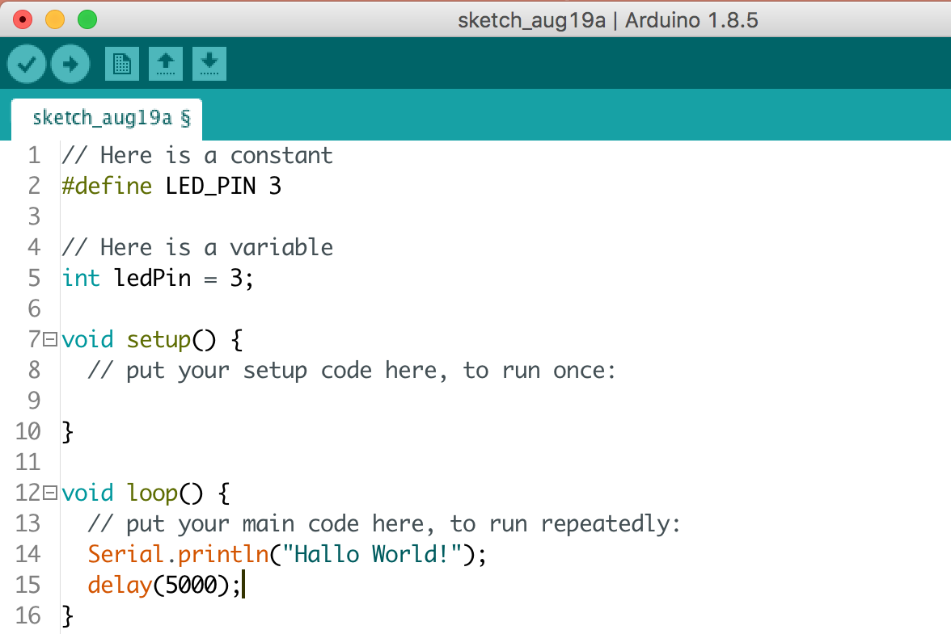
Creating Constants/Variables in Arduino
Constants once set, can’t change
Variables, however can change

Slide 23
Delays/Waiting
delay(1000);
delay(500);
What are we telling the delay function to do here?
delay is a function

Slide 24
Comments
// This is a single line comment
/* This is a
multiline comment
*/
Comments are NOT code
They just explain what the code is doing.
You should use them !!

Slide 25
Homework
Try and write your own version of the Blink Sketch.
In the handouts directory there is a file called homework-challenge.txt to help
https://www.github.com/nexgencodecamp/ytp/modules/arduino/04-coding-deeperdive/handouts

Slide 26


